Slide 1
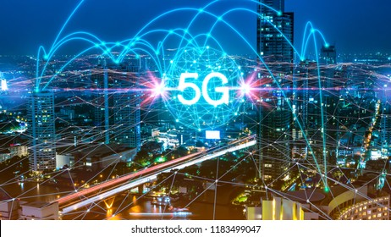
Presentation on 5G Technology
Presented to Sabyasachi Banerji sir
Guided by Mohammad Tahir Mirji
Presented by Priyanka .s. Bendigeri
Tanushree k

Slide 2
Introduction
5G Technology stands for 5th generation mobile technology. 5G denote the next major phase of mobile telecommunication standards beyond the upcoming 4G standards. 5G technology is offering the service in Product Engineering, Documentation, supporting electronic transactions, etc.
As the customer become more and more aware of the mobile phone technology, he or she will look for a decent package all together including all the advanced features a cellular phone can have. Hence the search for new technology always the main motive of the leading cell phone giants to out innovate their competitors. The goal of a 5G based telecommunication network would ideally answer the challenges that a 4G model would present once it has entered widespread use

Slide 3
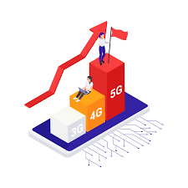
Evolution from 3G to 5G
3G can reach network speeds of 7.2 mbps, 4G can reach network speeds of 150 mbps and 5G will eventually reach speeds in excess of 1gbps (with a theoretical maximum of 20gbps!) Mileage varies depending on whether the individual browser is stationary or, say, in a moving vehicle.

Slide 4
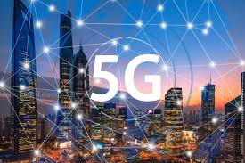
objectives of 5G Technologies
5G wireless technology is meant to deliver higher multi-Gbps peak data speeds, ultra low latency, more reliability, massive network capacity, increased availability, and a more uniform user experience to more users. Higher performance and improved efficiency

Slide 5
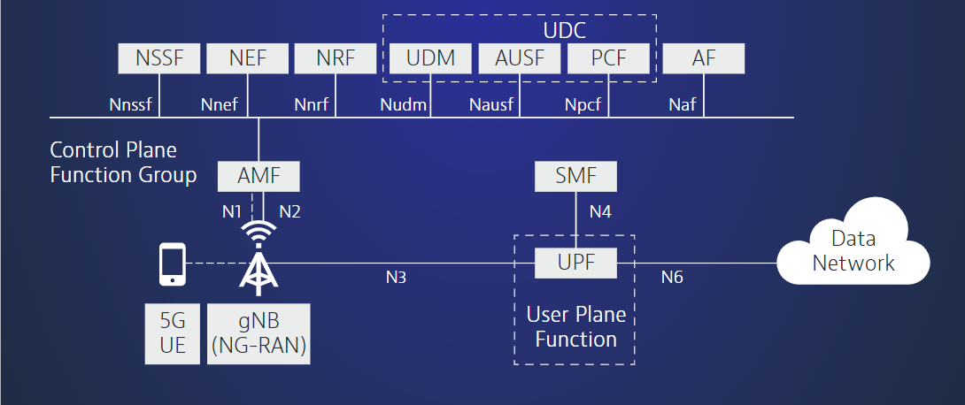
Architecture of 5G Technology
5G utilizes a more intelligent architecture, with Radio Access Networks (RANs) no longer constrained by base station proximity or complex infrastructure. 5G leads the way towards disaggregated, flexible, and virtual RAN with new interfaces creating additional data access points.

Slide 6
Advantages of 5G Technology
IMPORTANT ADVANTAGES
High resolution and bi-directional large bandwidth shaping.
Technology to gather all networks on one platform.
More effective and efficient.
Technology to facilitate subscriber supervision tools for the quick action.
Most likely, will provide a huge broadcasting data (in Gigabit), which will support more than 60,000 connections.
Easily manageable with the previous generations.

Slide 7
CONCLUSION
5G Technology stands for 5th Generation Mobile technology. 5G mobile technology has changed the means to use cell phones within very high bandwidth. User never experienced ever before such a high value technology.
Nowadays mobile users have much awareness of the cell phone (mobile) technology. The 5G technologies include all type of advanced features which makes 5G mobile technology most powerful and in huge demand in near future.

Slide 8
Thank you

